Slide 1
Case Study: Bike Share Analysis
Gabriel Brandao

Slide 2
Executive Summary
Task: Determine how annual members and casual riders use Cyclistic (data from a New York City based company) bikes differently.
Findings:
Members had a higher average number of weekday rides than casual riders. This difference varies by month.
Members averaged 11033 more rides per month than casual users during a 12-month period.
The customer type with higher average number of weekend rides varies by month. There is less difference here than for weekday rides and there is even overlap in some months throughout the year.
Casual riders will have a longer average ride length than members on both weekdays and weekends.
While the ride length from casual riders is dependent on the month, member ride length remained consistent for both weekday and weekend.
This suggests that any difference in ride length between the two groups is due to a change in average ride length within casual riders.

Slide 3
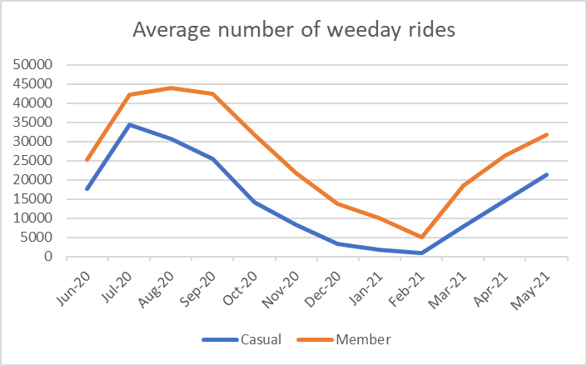
Average number of weekday rides by customer type
This chart illustrates finding number 1 (Higher average number of weekday rides from members than from casual riders.)
Members averaged 11033 more rides per month than casual riders during a 12-month period.
The difference between the number of rides between user types is greatest from the period of August 2020 until January 2021

Slide 4
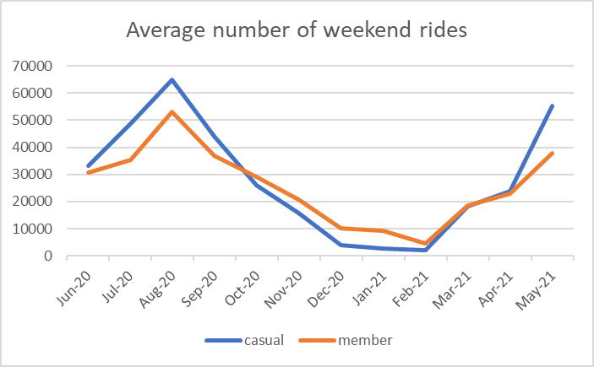
Average number of weekend rides by customer type
This chart illustrates finding number 2 (The customer type with higher average number of weekend rides varies by month.
There are more casual weekend riders from June 2020 through October 2020, and again from April 2021 through May 2021.
This is probably due to casual riders taking advantage of the nicer weather of those months for weekend rides.

Slide 5
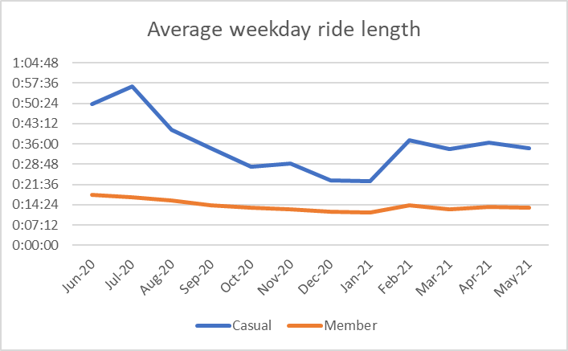
Average weekday ride length by customer type
This chart illustrates finding number 3 (Casual riders will have a longer average ride length than members on both weekdays and weekends).
The difference in average ride length between the warmer and colder months is more apparent in casual riders than members.
Average ride length between members tends to be consistent throughout the 12-month period.

Slide 6
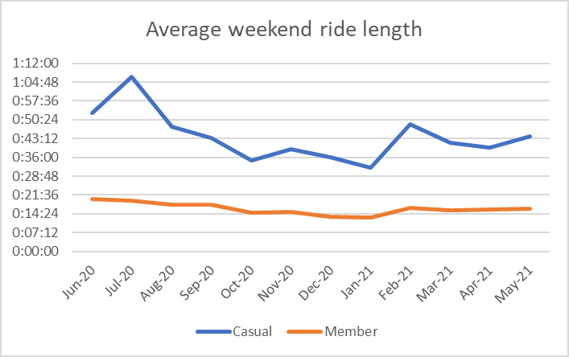
Average weekend ride length by customer type
This chart also illustrates finding number 3.
This chart is very similar to the previous one in that casual riders have longer average ride lengths.
These ride lengths tend to be longer in warmer months than colder ones.
Member ride lengths stay relatively consistent throughout the 12-month period.

Slide 7
Next Steps
Marketing suggestion:
target causal riders and show them the benefits/convenience of having an annual membership. Designing a marketing campaign around the fact that casual riders spend so much time on bikes should be effective.
2. Important information to collect
Survey causal riders to find out if they use other modes of transportation such as public transport, other bike share, or ride share apps. If this is the case make a point of how Cyclistic is more convenient and a better solution.
Spotify approach
Make casual users aware of how much time they are and how much distance they covered using Cyclistic bikes through a monthly breakdown of their rides (if you have the legal means to store their data). This can be done through emails or text messages.

